Slide 1
Attributes of Functional Network Architecture Supporting Skilled Reading
Stephen Bailey
October 24, 2018

Slide 2
Agenda
1. Modular brain networks
2. The brain at rest
3. The brain during reading
4. The brain during many tasks
5. Takeaways
Notes:
Brain

Slide 3
Agenda
1. Modular brain networks
2. The brain at rest
3. The brain during reading
4. The brain during many tasks
5. Takeaways
Notes:
Brain

Slide 4

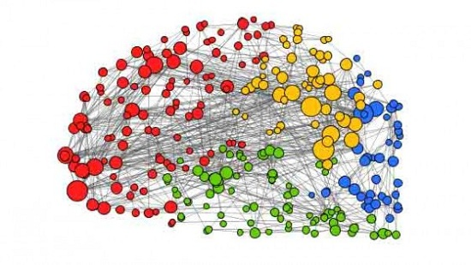
What is the brain?
The brain is a supercomputer
The brain is a complex network
Many different circuits and transformers responsible for specific computations
Many communities of neurons dynamically interacting within and between themselves

Slide 5
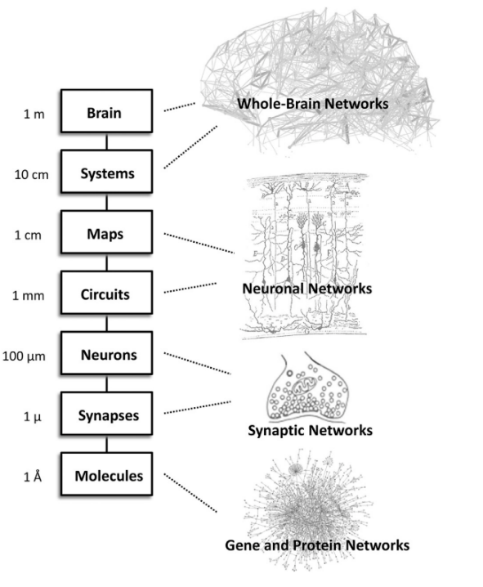
Brain Organization Supports Function
Petersen et al., 2015

Slide 6
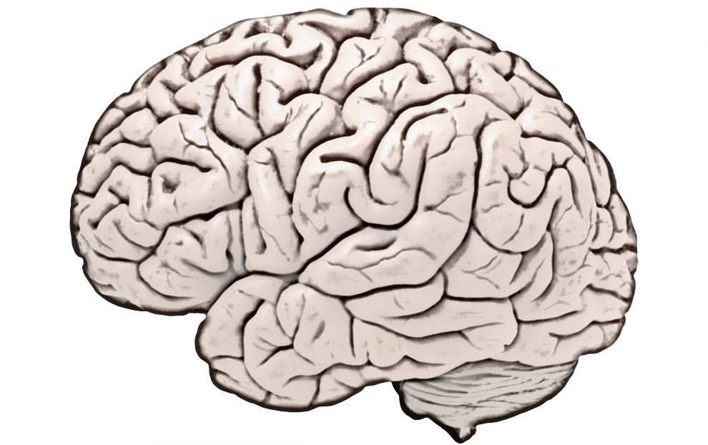
The brain

Slide 7
The brain does many things.

Slide 8
The brain sees things.
Visual
Processing

Slide 9
The brain sees things.
Visual
Processing

Slide 10
The brain hears things.
Auditory
Processing
Visual
Processing

Slide 11
The brain moves things.
Motor &
Planning
Auditory
Processing
Visual
Processing

Slide 12
The brain interprets things.
Motor &
Planning
Semantic
Processing
Auditory
Processing
Visual
Processing

Slide 13
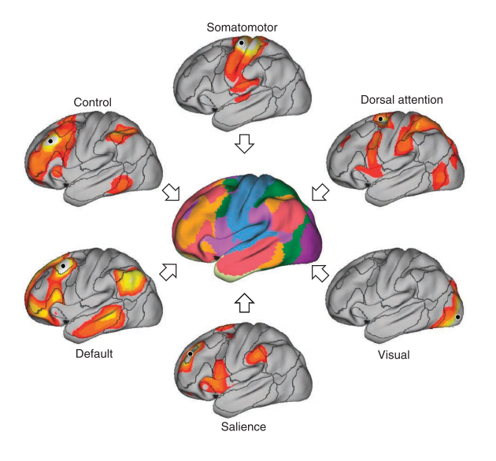
Resting-State Networks
Modules can be identified with resting-state functional MRI
There are between 7 – 17 distinct modules in the brain
Buckner et al., 2013

Slide 14
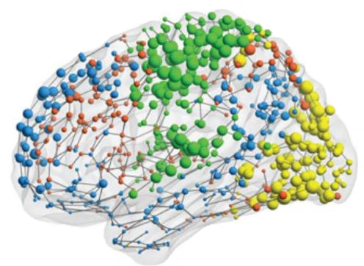
Why modular?
Robust to injury
Parallel processing
Evolvable
Metabolic Efficiency
Isolating processes from each other makes them less impacted if one fails.
Instead of reorganizing whole system, add new modules.
By grouping similar tissue, less long-distance “wiring” has to occur.
Multiple processes (vision, hearing, etc.) can occur simultaneously.
Vertes et al., 2014

Slide 15
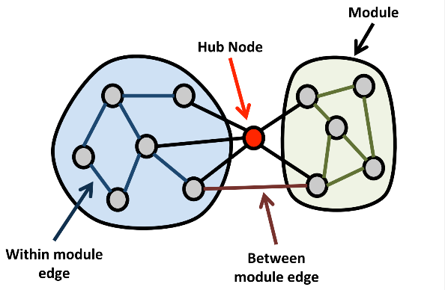
How does network architecture support cognitive skills?
Resting-state networks can be integrated through hub regions.
When a traumatic injury or stroke disrupts the network, there are catastrophic consequences.
Do differences in network architecture lead to differences in cognitive processing?

Slide 16

The brain reads a book.
Notes:
To see why,

Slide 17


When tweetle beetles battle
in a bottle with their paddles
and the bottle's on a poodle
and the poodle's eating noodles...
They call this a
muddle puddle tweetle
poodle beetle noodle
bottle paddle battle.

Slide 18
The brain reads a book.
Motor &
Planning
Integration Across
Resting-State Networks,
esp. via Hubs
Semantic
Processing
Auditory
Processing
Visual
Processing

Slide 19
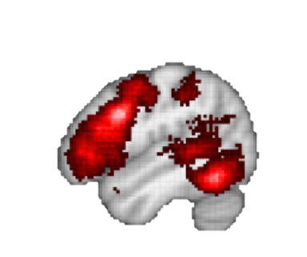
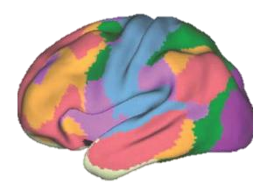
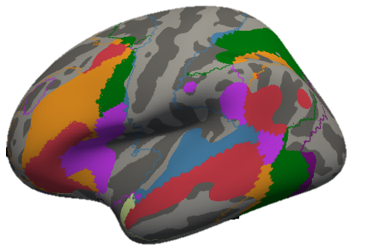
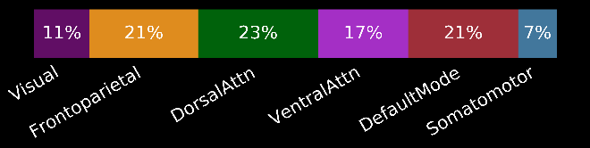
Reading relies on a number of resting-state networks
NeuroSynth “Reading”
Yeo 2011 Networks
Bailey et al., 2018

Slide 20
How do differences in network architecture influence cognitive skills?
Reading skill is an ideal model because it is integrative and variable
We will investigate this relationship in a three different studies of different types of brain networks.
Rest
Tones
Listening
Reading
Symbols
Network Organization
Reading Proficiency

Slide 21
Agenda
1. Modular brain networks
2. The brain at rest
3. The brain during reading
4. The brain during many tasks
5. Takeaways
Rest
Tones
Listening
Reading
Symbols

Slide 22
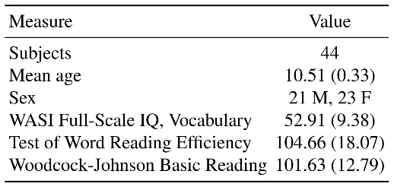

Resting-State Functional MRI (fMRI)
fMRI is used to measure patterns of metabolic activity across the brain.
Resting-state connectivity is known as “intrinsic connectivity”.
We had 44 fourth graders participate.
Notes:
Make this about resting-state fMRI
Set up

Slide 23
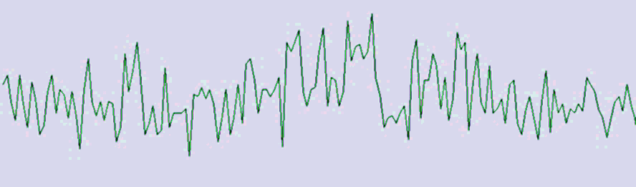
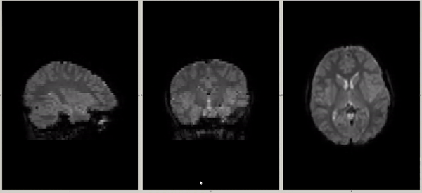
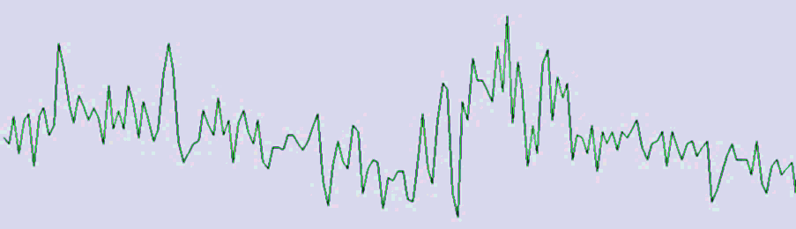
BOLD Signal Timeseries (5m)
r_{1,3} = 0.79
fMRI GIF
r_{1,2} = 0.03

Slide 24
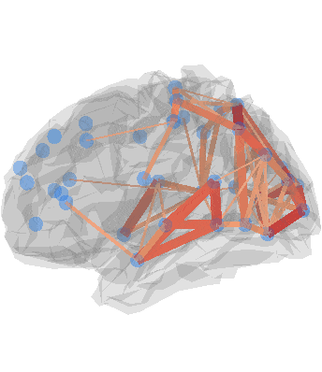
Methods: Connectivity analysis
Extract timeseries data from regions across the brain.
Correlate each region with each other region.
Calculate modularity.
Compare with reading scores.
¹ Power et al., 2011
Notes:
One of the chief insights about the "resting" brain is that it segregates into densely intra-connected resting-state networks. These include primary sensory regions but also associative and executive networks. Complicated cognitive tasks such as reading and listening comprehension require rapid coordination between these different networks, but how they transiently reorganize during different language use has not been well-described.

Slide 25

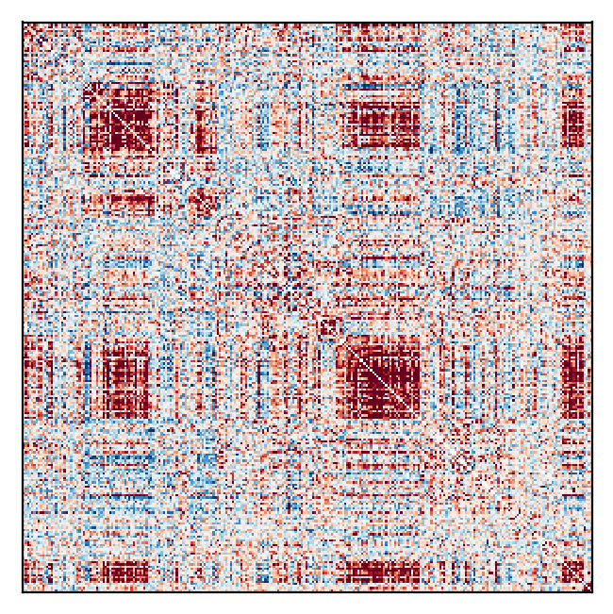
Calculating modularity of a network
Node X
Create a correlation matrix.
Node X

Slide 26
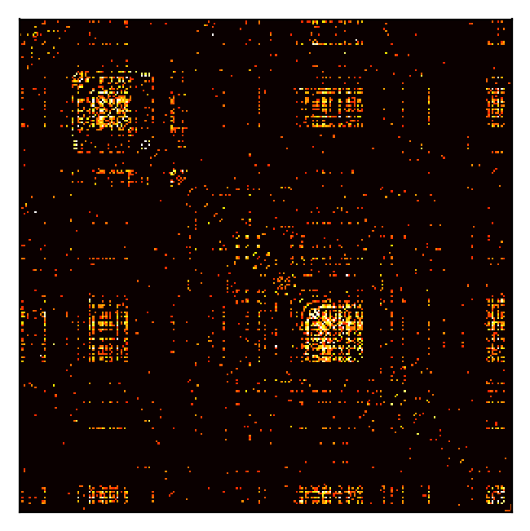
Calculating modularity of a network
Create a correlation matrix.
Eliminate 90% - 98% of links.

Slide 27
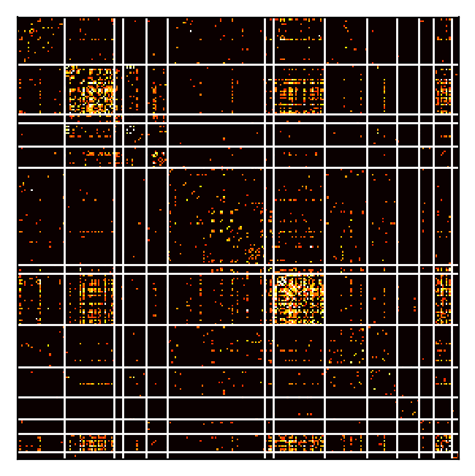
Calculating modularity of a network
RSN 1
RSN 1
Create a correlation matrix.
Eliminate 90% - 98% of links.
Assign each node to a network.

Slide 28
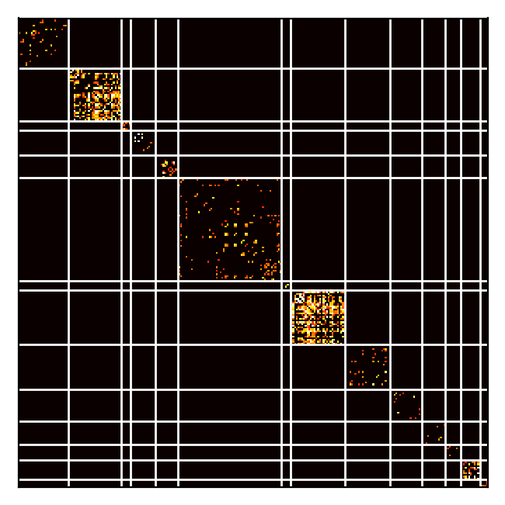
Calculating modularity of a network
Create a correlation matrix.
Eliminate 90% - 98% of links.
Assign each node to a network.
Calculate modularity, based on within- vs. between-network.

Slide 29

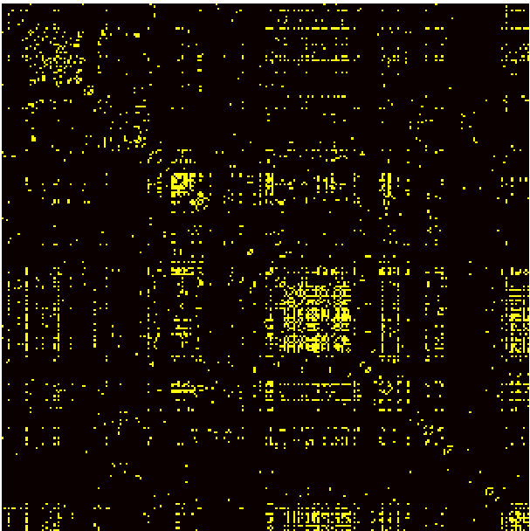
Modular organization is present
Unthresholded
Thresholded

Slide 30
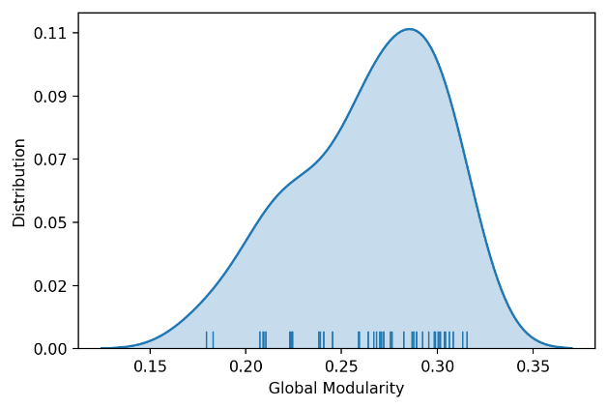
Modular organization is present
At a threshold of 5% connections retained, the range of modularity values falls between 0.18 – 0.33.

Slide 31

Reading Skill: Test of Word Reading Efficiency
Total Word Reading Efficiency
Sight Word Efficiency
Phonemic Decoding Efficiency
Book
Wood
Fast
Bave
Pate
Barp

Slide 32
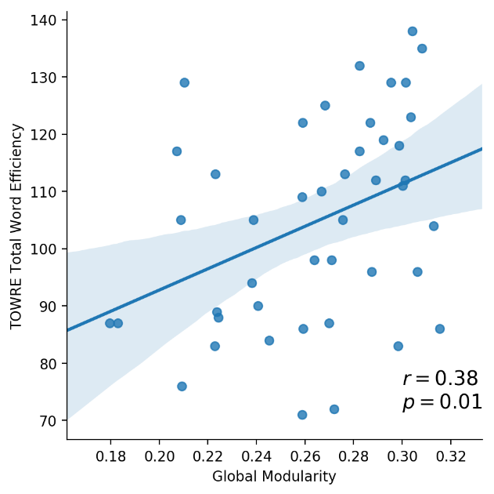
Modularity Predicts Reading Skill
A larger proportion of within-module connections was associated with better reading skill.

Slide 33
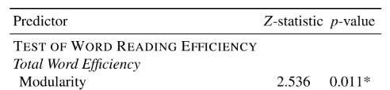
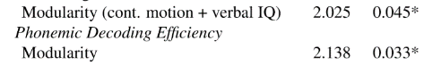
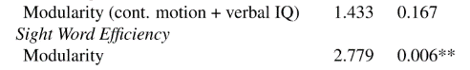
Modularity predicts Sight Word Efficiency
The relationship with reading skill is significant, even adding in motion and verbal IQ covariates.
It is less correlated with just Phonemic Decoding Efficiency
It is more highly correlated for Sight Word Efficiency

Slide 34
Takeaways for Study 1
Children adopt a modular network architecture consistent with previous literature.
Higher global modularity at rest is associated with better reading skill.
Does this relationship change during reading?

Slide 35
Agenda
1. Modular brain networks
2. The brain at rest
3. The brain during reading
4. The brain during many tasks
5. Takeaways
Rest
Tones
Listening
Reading
Symbols

Slide 36
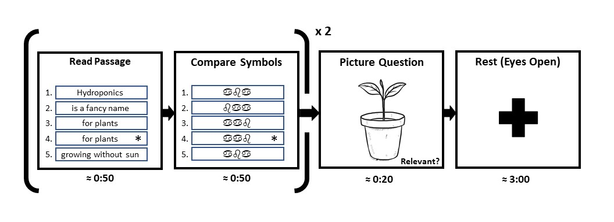
Functional MRI Task Design
Time
7:30

Slide 37
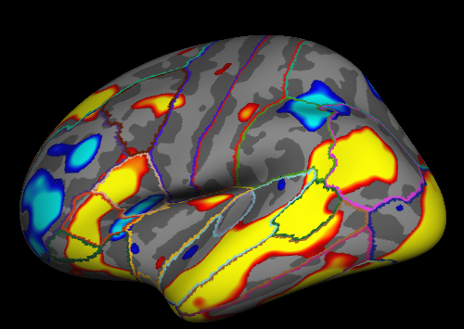

Functional MRI Activation Results
Red = “Activated” during reading; Blue = “Deactivated” during reading

Slide 38
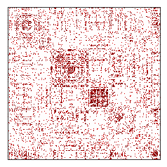
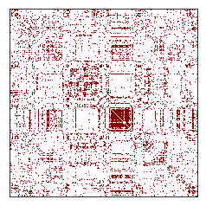
Network analysis methods
Extract connectivity data from 264 ROIs.
Construct condition-specific arrays using weighted-GLM.
Keep top 5% of connections.
Analyze:
Global modularity
System-specific rewiring
Read
Rest
¹ Power et al., 2011
Notes:
One of the chief insights about the "resting" brain is that it segregates into densely intra-connected resting-state networks. These include primary sensory regions but also associative and executive networks. Complicated cognitive tasks such as reading and listening comprehension require rapid coordination between these different networks, but how they transiently reorganize during different language use has not been well-described.

Slide 39
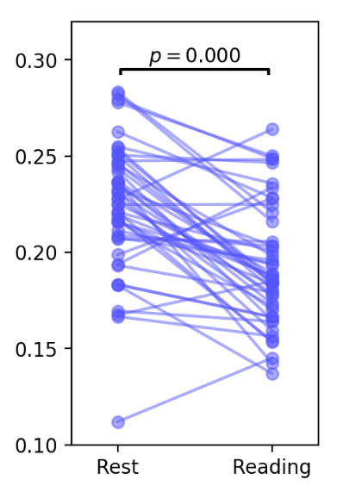
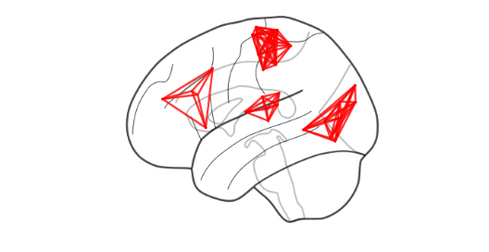
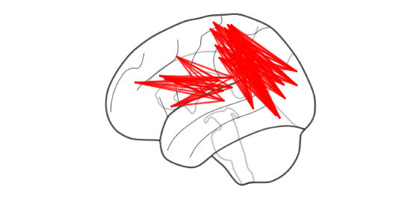
Reading decreases modularity
High modularity
Low modularity

Slide 40
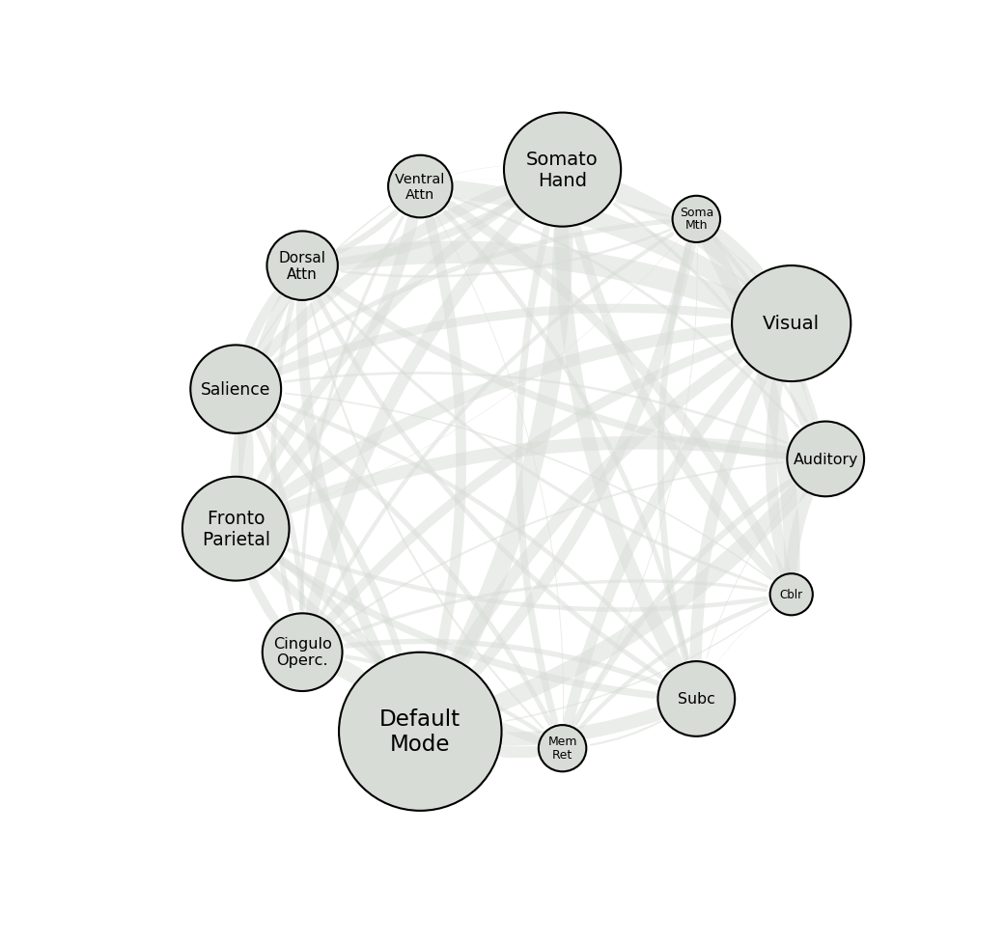
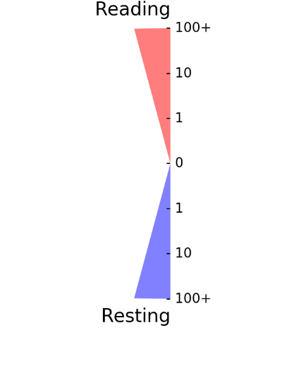
Connectivity Changes in Reading
Attention
Sensory
Executive
Subcortical

Slide 41
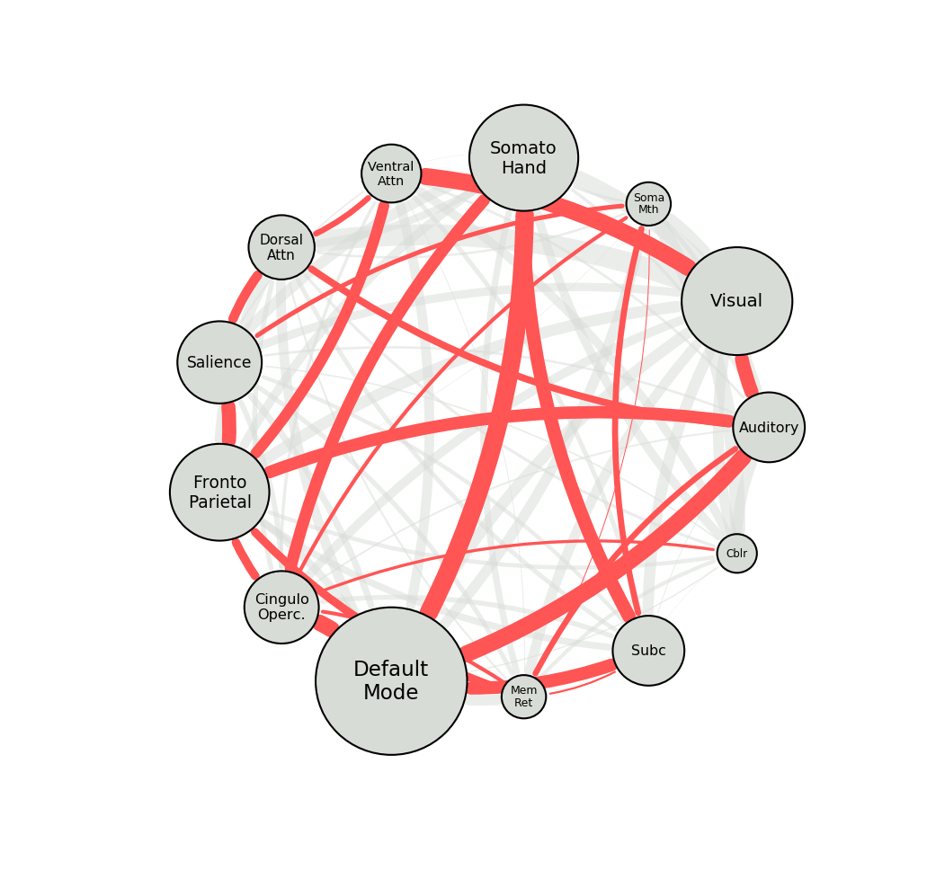
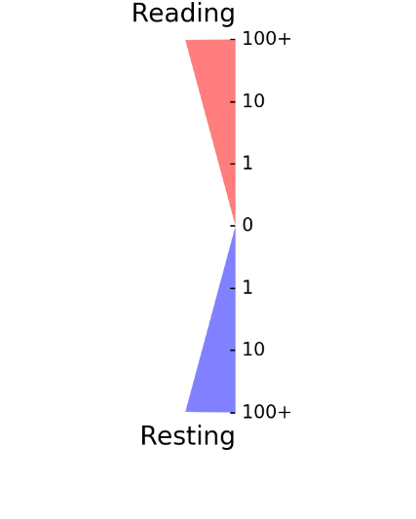
Connectivity Changes in Reading
Attention
Sensory
Reading increases many between-network connections.
Executive
Subcortical

Slide 42
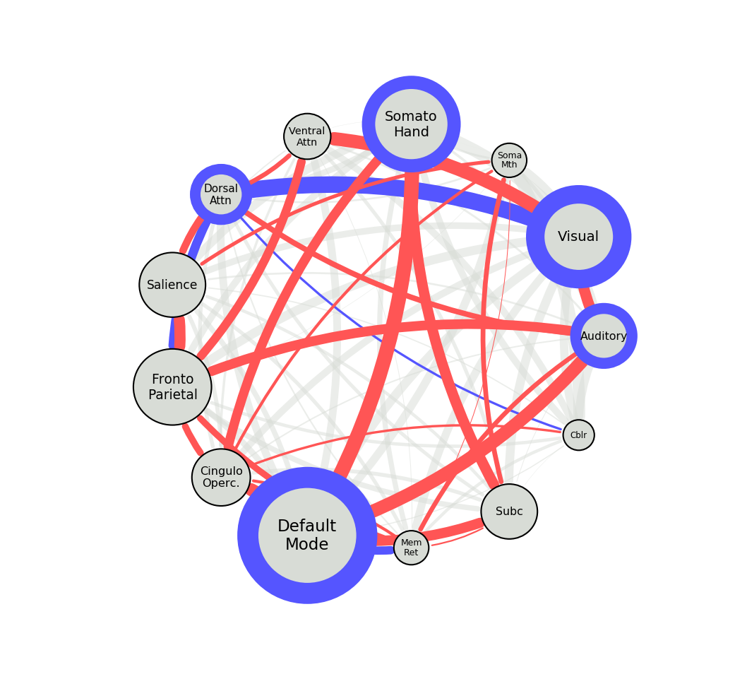

Connectivity Changes in Reading
Attention
Sensory
Reading increases many between-network connections.
Reading decreases sensory network clustering, and connectivity with dorsal attention network
Executive
Subcortical

Slide 43
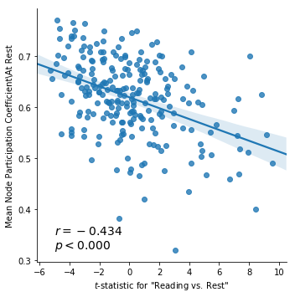

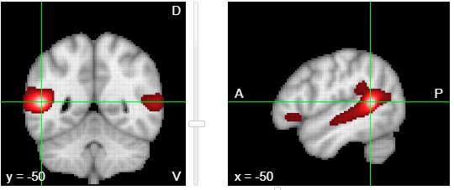
In general, hub network is deactivated, but some critical connectors are active.
Hubs
Active Hubs
Active

Slide 44
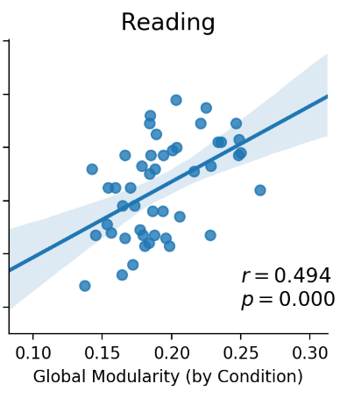

Correlation of modularity and reading skill persists during reading

Slide 45
Takeaways for Study 2
Children adopt a modular network architecture.
Higher global modularity at rest and during reading is associated with better reading skill.
Only a few hub areas become activated during reading.
How consistent is network architecture across many tasks?

Slide 46
Agenda
1. Modular brain networks
2. The brain at rest
3. The brain during reading
4. The brain during many tasks
5. Takeaways
Rest
Tones
Listening
Reading
Symbols

Slide 47

Variable but similar?
We found significant differences between reading-evoked and resting-state network architecture.
But both are modular, and higher modularity is related to reading skill.

Slide 48
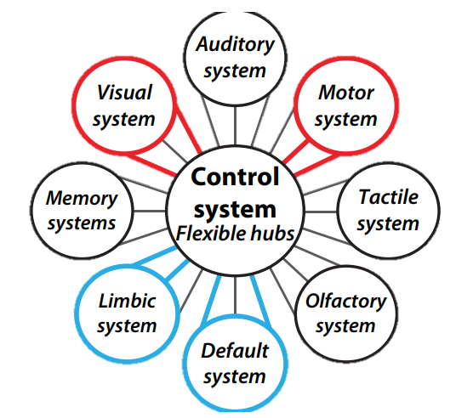
Connector Hubs and The Fronto-Parietal Network
Connector hubs are likely critical to keeping a similar structure across many tasks.
The fronto-parietal network appears to contain many of these connector hubs.
Do connectivity patterns within the fronto-parietal network play a special role in cognition?
Koziol et al., 2014

Slide 49
Calculating Network Similarity
We have been using modularity, which uses a reference partition.
Maybe some subjects or task-states have more “unique” groupings?
Other metrics, such as the Intersection of the Union, provide a less biased way of evaluating similarity.
2
3
1
1
3
2
Reference
Modules

Slide 50
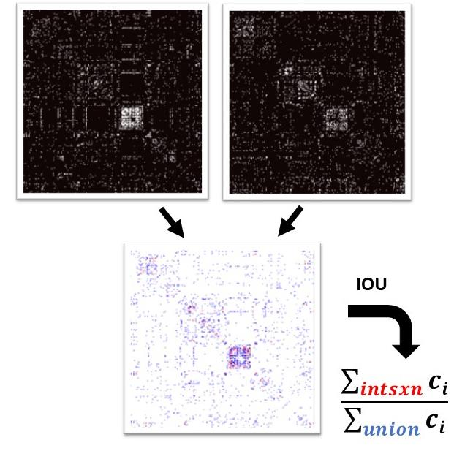
Calculating the Intersection of the Union
Subject 1
Listening
Subject 1
Reading
Divide the number of SHARED connections by the number of connections in EITHER network.
Result is between 0 – 1, strongly related to the number of shared connections.

Slide 51
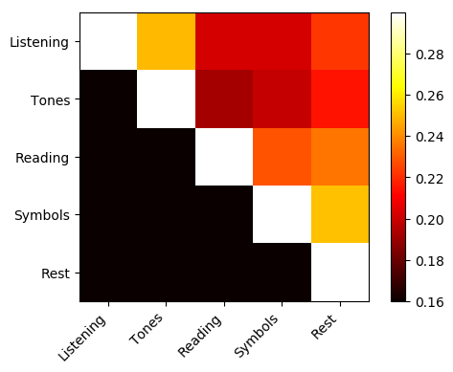
Tasks show a high degree of similarity
Overall, task-evoked networks had IOUs between 0.15 to 0.30 with each other.
The visual – to – listening relationships had the least similarity…
But even there, about ¼ of the connections were shared.
Mean
IOU

Slide 52
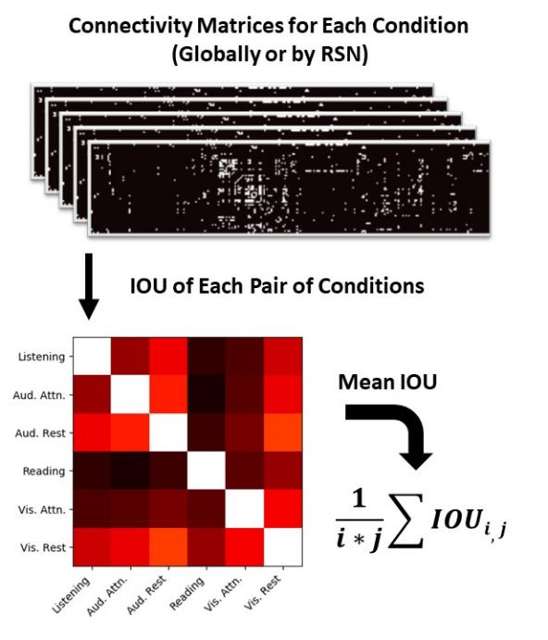
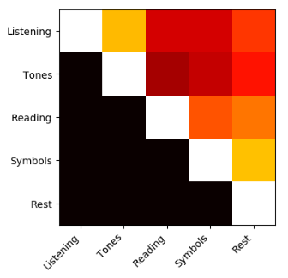
Calculating Within-Subject Network Variability
For each subject…
Select nodes
Calculate IOU between each pair of conditions.
Get mean similarity
Compare across subjects

Slide 53
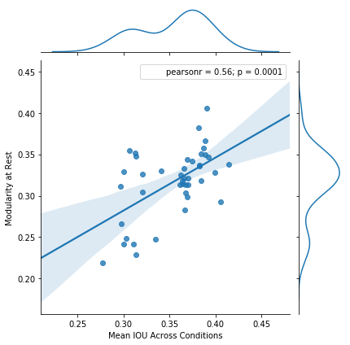
Subjects with less variability had higher modularity at rest.
Across the whole network, average similarity across tasks was 0.364.
More modular brains also tended to show less variability between tasks.
Modularity at Rest
Mean IOU

Slide 54
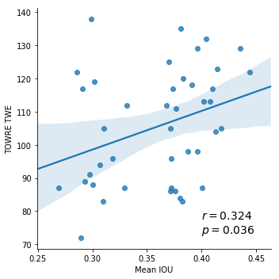
High Similarity Correlates with Reading Skill
More similarity between tasks is associated with better reading skill.
TOWRE TWE
Mean IOU

Slide 55
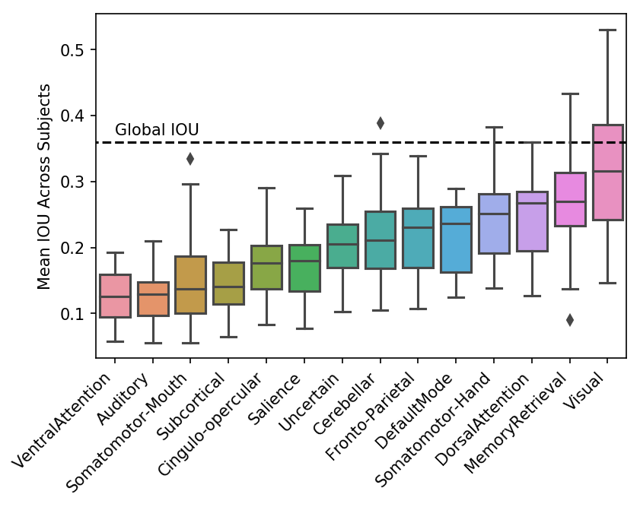
Networks differ in their degree of similarity
Mean IOU across Subjects
RSNs showed a variable amount of similarity between tasks.
Auditory, somato-motor and ventral attention networks were most variable.

Slide 56
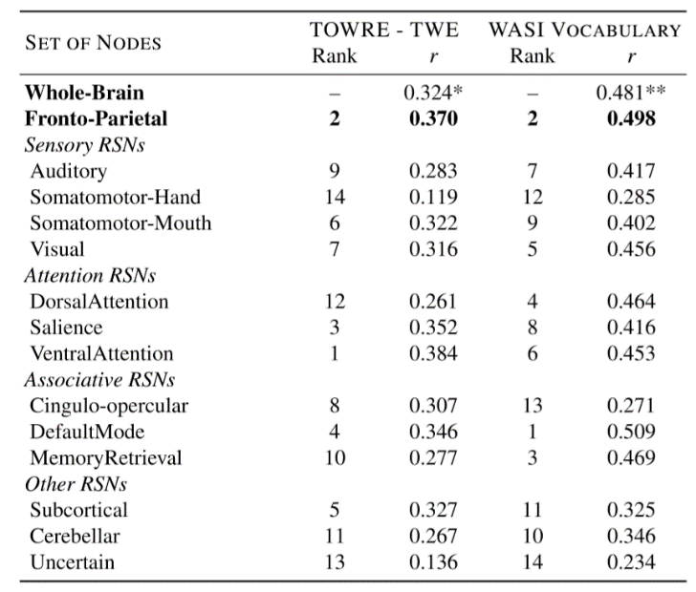
Similarity in the Fronto-Parietal Network is correlated with cognitive skills
Of all the RSNs, similarity within the fronto-parietal network was most indicative of both reading and vocabulary skill.
The “uncertain” nodes were least predictive

Slide 57
Takeaways for Study 3
Children adopt a modular network architecture consistent with our reference.
Higher global modularity at rest and during reading is associated with better reading skill.
Reading decreases modularity, esp. within default mode, visual, auditory and dorsal attention systems.
There is a strong functional network “backbone” that is present across all tasks.
Less variability in this backbone is related to higher reading skill, and verbal intelligence.

Slide 58
Agenda
1. Modular brain networks
2. The brain at rest
3. The brain during reading
4. The brain during many tasks
5. Takeaways

Slide 59
A modular model for reading
Robust to injury
Parallel processing
Evolvable
Efficient
Vertes et al., 2014

Slide 60
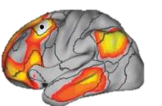





Reading comprehension is highly integrative
Distributed processing
Active binding
Efficient integration
Scarborough 1999

Slide 61

A modular model for cognition
Specific cognitive processes are largely done in densely connected modules.
Connector hubs integrate information between these modules.
Hubs allow – even tune – other nodes to “focus on” modular processes.
^{Bertolero et al., 2018}

Slide 62


Future directions: Development
Individualized network analysis

Slide 63

Future directions: Dynamic connectivity

Slide 64





Acknowledgements
Vanderbilt University Institute for Imaging Science
Vanderbilt Brain Institute
Education and Brain Research Lab
Funding
NIH R01 HD044073
NIH R01 HD067254
NIH F31 HD090923
Software
FMRIB Software Library
CONN Toolbox
Brain Connectivity Toolbox
NiPy

Slide 65
Not all those who wander are lost.
But some are.
And that’s okay.

Slide 66


Notes:
Great friends and team, enjoyed the work, world travel, two kids, set me up for an exciting career

Slide 67


Goals
Validate that listening and reading are integrative
Determine differences in system-level interactions
Sensory
Attention
Executive
Subcortical
High modularity
Low modularity

Slide 68

Listening and reading elicit a common “language core”
Add negative data
Show positive + negative views
Bilateral activity but biased to the left side
Visual and oculomotor areas in reading
p < 0.01, TFCE-corrected, FSL randomise

Slide 69




Reading induces a more integrated network structure than listening
Higher in
Listening
Reading induces a lower modularity than listening.
This is driven largely by decreases in connectivity of the visual system and increases to long-range connections.
Visual
Higher in
Reading
Dorsal
Attention

Slide 70

Calculating the Intersection of the Union
Subject 1
Listening
Subject 2
Listening
Divide the number of SHARED connections by the number of connections in EITHER network.
Result is between 0 – 1, strongly related to the number of shared connections.

Slide 71
Calculating the Intersection of the Union
Subject 1
Reading
Subject 2
Reading
Divide the number of SHARED connections by the number of connections in EITHER network.
Result is between 0 – 1, strongly related to the number of shared connections.

Slide 72


Does listening-to-reading similarity predict reading skill?

Slide 73

Subject-to-Subject Similarity in Listening and Reading

Slide 74

Subject-to-Subject Similarity in Listening and Reading
Subjects’ “listening-evoked” networks are more similar than subjects’ reading-evoked networks.
Possibly because listening is more “natural” than reading. Does reading become more “natural” in better readers?

